Slide 1

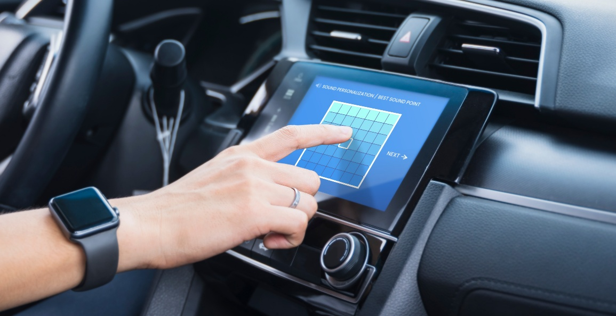
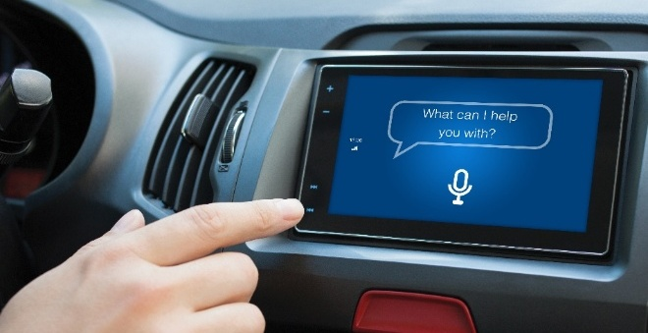


Alango Solutions
VOICE COMMUNICATION
SOUND PERSONALIZATION
Voice Communication Package (VCP)
Sound Reinforcement Package (SRP)
PersonaSound™
SPEECH RECOGNITION
MUSIC ENHANCEMENT
SOUND ACQUISITION
Voice Enhancement Package (VEP)
Voice Activity Detector (VAD)
Audio Enhancement Package (AEP)
Auto Volume & Frequency Equalization (EQ)
SonicVibrance™
SoundAround™
SoundDetector™

