Slide 1

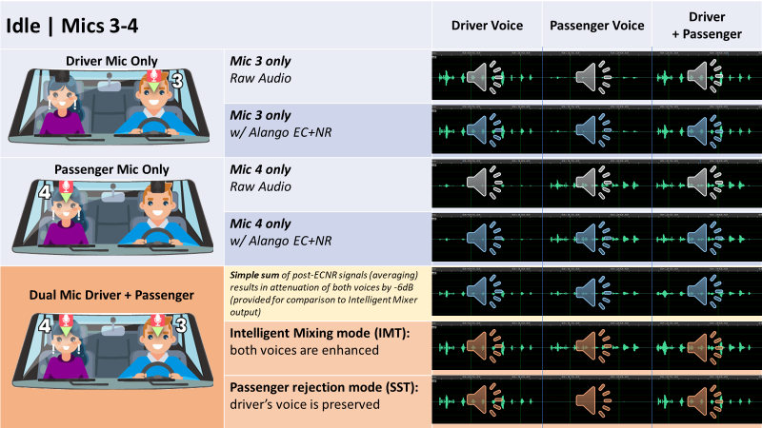
Guide to audio demonstration slides
The noise scenario and mic configuration appear here:
Noise: Idle / 80kmh
Mic configuration: 3-4 / 1-2
Echo or No echo
The 7 speech types are ordered in columns:
Driver voice
Passenger voice
Driver + passenger voice simultaneous
* Echo only (far end voice)
* Driver + echo
* Passenger + echo
* Driver + passenger + echo
*The speech types with echo are presented on separate slides.
The 7 sound signal signals are ordered in rows:
Driver mic raw audio
Driver mic with ECNR
Passenger mic raw audio
Passenger mic with ECNR
Simple sum (average) of driver and passenger mics, after ECNR
Intelligent Mixer – Mixing mode (IMT)
Intelligent Mixer – Passenger rejection mode (SST)
Click on any icon to play the corresponding sound file.
For example, these sounds are all Passenger voice only, for each of the 7 sound signals. They correspond to an idle car with 3-4 mic configuration

Slide 2
How to listen: Passenger rejection mode
Consider the case where both the driver and passenger are talking simultaneously.
In Passenger Rejection Mode (SST), the driver’s voice is preserved while the passenger’s voice, ambient noise and echo are attenuated.
To hear the effect of the intelligent mixer in SST mode, listen to the sound files and compare between them:
Raw audio (driver’s mic)
Single-mic ECNR output (driver’s mic)
IntelliMix processed output, passenger rejection mode
On the slides that follow (slides 7-14),
Click on a sound icon to play the associated .wav file

Slide 3
How to listen: Intelligent Mixing mode
In Intelligent Mixing Mode (IMT), both the driver’s and passenger’s voices are preserved, while ambient noise and echo are attenuated. This is most easily observed in example files where driver and passenger speak simultaneously.
To hear the effect of the intelligent mixer in IMT mode, listen to the sound files and compare between them:
Raw audio (driver’s mic)
Raw audio (passenger’s mic)
Single-mic ECNR output (driver’s mic)
Single-mic ECNR output (passenger’s mic)
Simple sum of post-ECNR signals
(i.e. no Intelligent Mixer processing)
Intelligent Mixer processed output
On the slides that follow (slides 7-14),
Click on a sound icon to play the associated .wav file

Slide 4
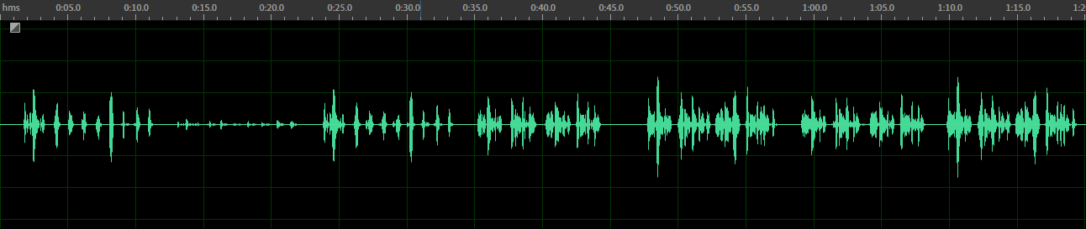


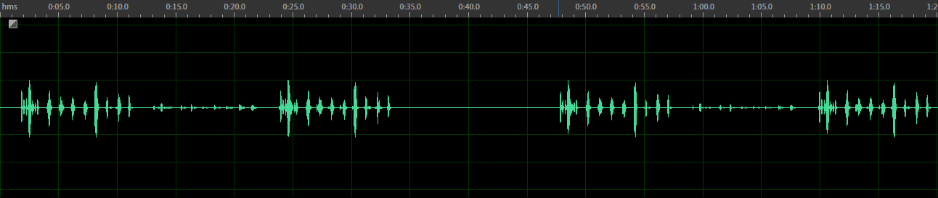
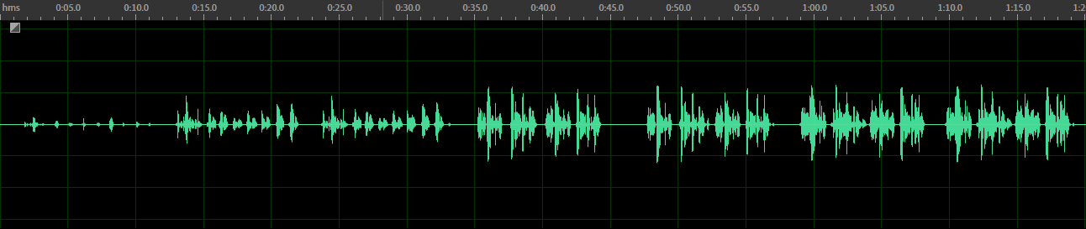

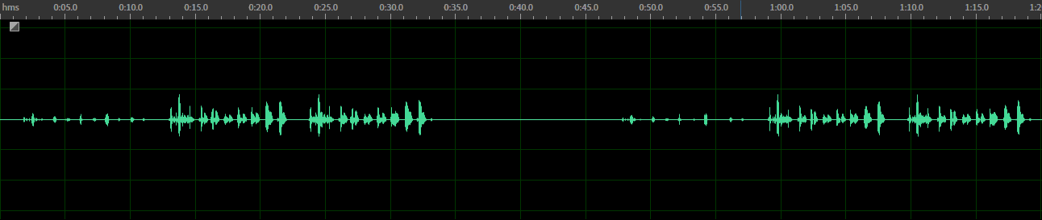
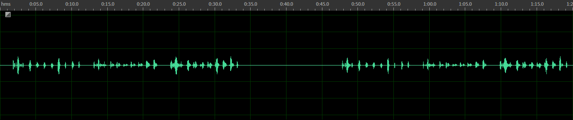

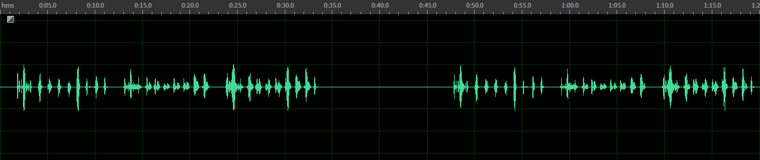
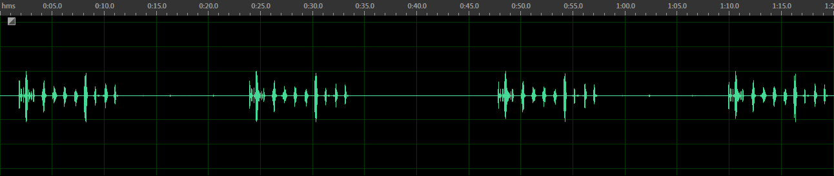
Idle | Mics 3-4 |  | Driver Voice | Passenger Voice | Driver + Passenger
Driver Mic Only | Mic 3 only Raw Audio
 | Mic 3 only w/ Alango EC+NR
Passenger Mic Only | Mic 4 only Raw Audio
 | Mic 4 only w/ Alango EC+NR
Dual Mic Driver + Passenger | Simple sum of post-ECNR signals (averaging) results in attenuation of both voices by -6dB (provided for comparison to Intelligent Mixer output)
 | Intelligent Mixing mode (IMT): both voices are enhanced
 | Passenger rejection mode (SST): driver’s voice is preserved

Slide 5
Idle | Mics 3-4 | With echo |  | Echo Only | Driver + Echo | Passenger + Echo | Driver + Passenger + Echo
Driver Mic Only | Mic 3 only Raw Audio
 | Mic 3 only w/ Alango EC+NR
Passenger Mic Only | Mic 4 only Raw Audio
 | Mic 4 only w/ Alango EC+NR
Dual Mic Driver + Passenger | Simple sum of post-ECNR signals (averaging) results in attenuation of both voices by -6dB (provided for comparison to Intelligent Mixer output)
 | Intelligent Mixing mode (IMT): both voices are enhanced
 | Passenger rejection mode (SST): driver’s voice is preserved

Slide 6
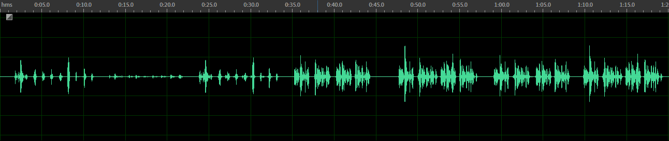

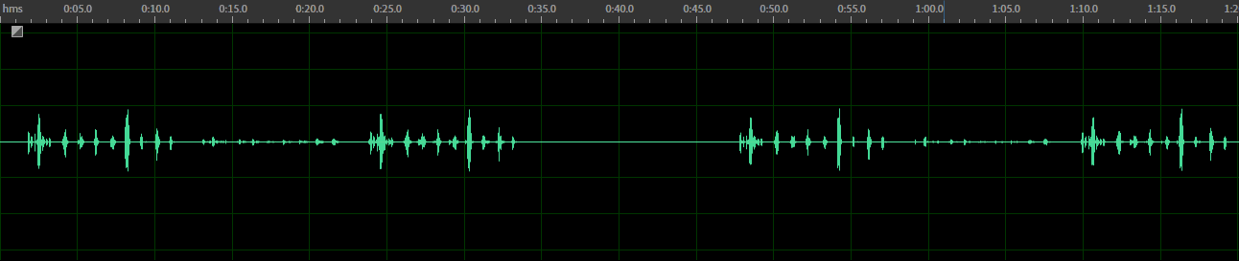
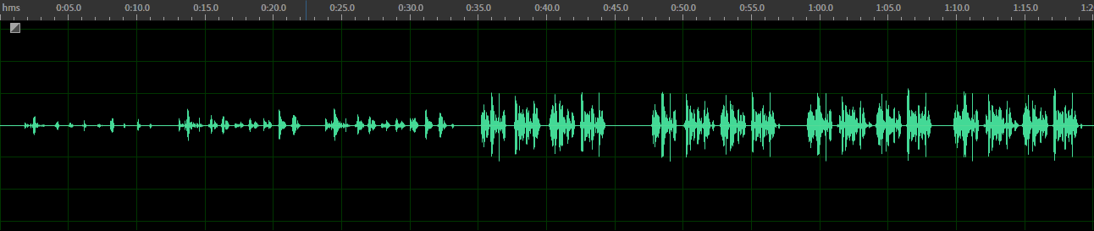

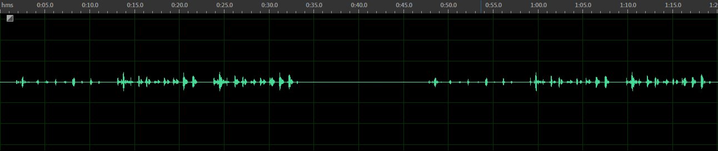
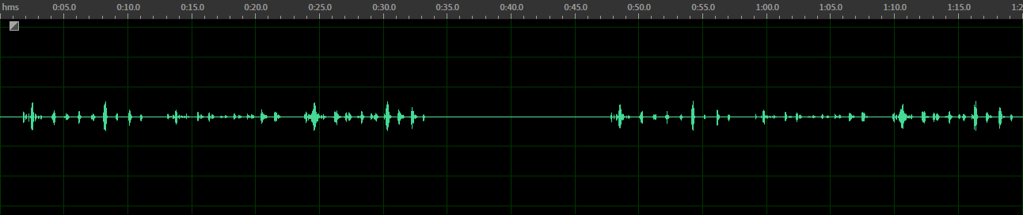

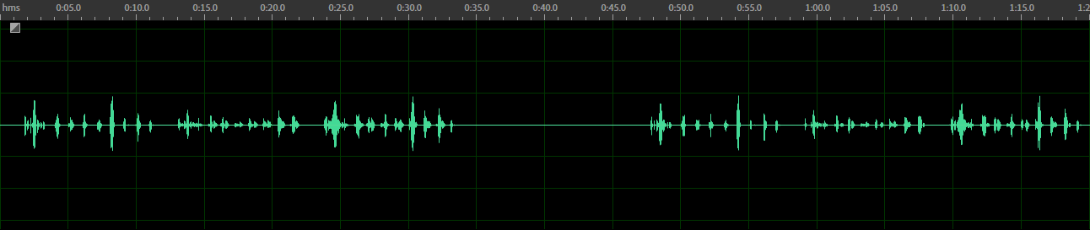
Idle | Mics 1-2 |  | Driver Voice | Passenger Voice | Driver + Passenger
Driver Mic Only | Mic 1 only Raw Audio
 | Mic 1 only w/ Alango EC+NR
Passenger Mic Only | Mic 2 only Raw Audio
 | Mic 2 only w/ Alango EC+NR
Dual Mic Driver + Passenger | Simple sum of post-ECNR signals (averaging) results in attenuation of both voices by -6dB (provided for comparison to Intelligent Mixer output)
 | Intelligent Mixing mode (IMT): both voices are enhanced
 | Passenger rejection mode (SST): driver’s voice is preserved

Slide 7
Idle | Mics 1-2 | With echo |  | Echo Only | Driver + Echo | Passenger + Echo | Driver + Passenger + Echo
Driver Mic Only | Mic 1 only Raw Audio
 | Mic 1 only w/ Alango EC+NR
Passenger Mic Only | Mic 2 only Raw Audio
 | Mic 2 only w/ Alango EC+NR
Dual Mic Driver + Passenger | Simple sum of post-ECNR signals (averaging) results in attenuation of both voices by -6dB (provided for comparison to Intelligent Mixer output)
 | Intelligent Mixing mode (IMT): both voices are enhanced
 | Passenger rejection mode (SST): driver’s voice is preserved

Slide 8
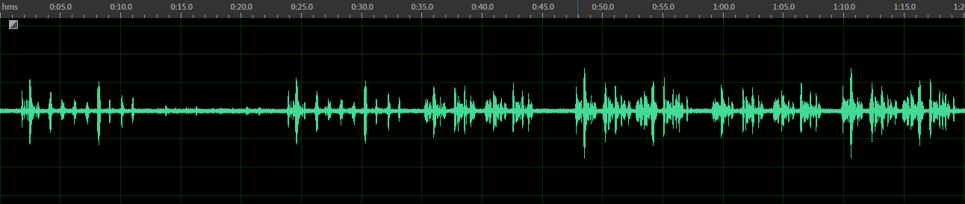
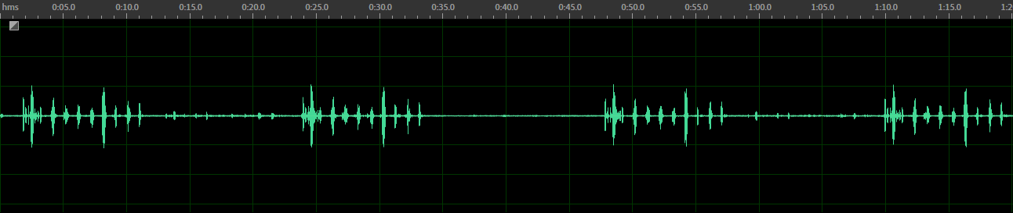
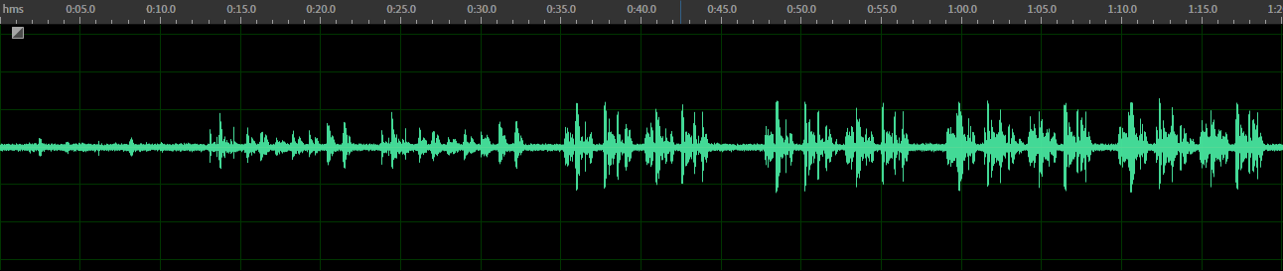
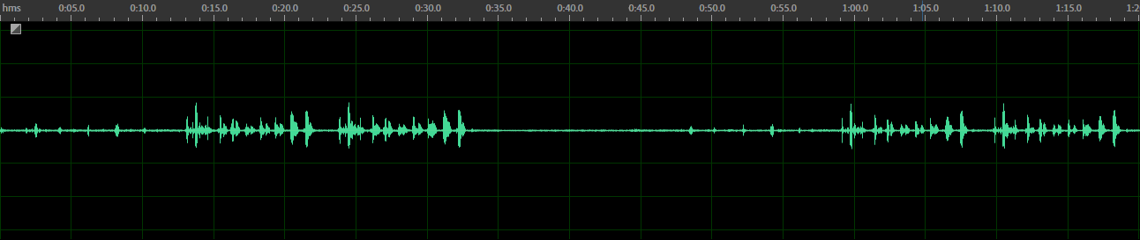
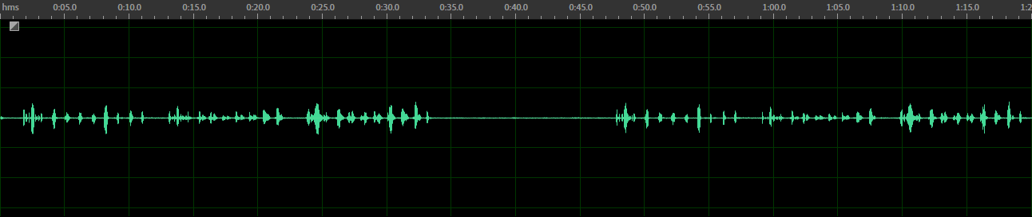
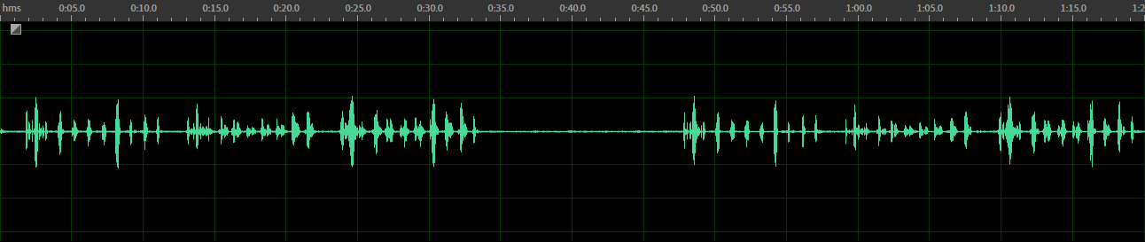
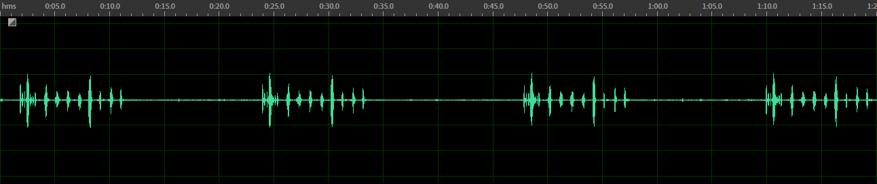
80 km/h | Mics 3-4 |  | Driver Voice | Passenger Voice | Driver + Passenger
Driver Mic Only | Mic 3 only Raw Audio
 | Mic 3 only w/ Alango EC+NR
Passenger Mic Only | Mic 4 only Raw Audio
 | Mic 4 only w/ Alango EC+NR
Dual Mic Driver + Passenger | Simple sum of post-ECNR signals (averaging) results in attenuation of both voices by -6dB (provided for comparison to Intelligent Mixer output)
 | Intelligent Mixing mode (IMT): both voices are enhanced
 | Passenger rejection mode (SST): driver’s voice is preserved

Slide 9
80 km/h | Mics 3-4 | With echo |  | Echo Only | Driver + Echo | Passenger + Echo | Driver + Passenger + Echo
Driver Mic Only | Mic 3 only Raw Audio
 | Mic 3 only w/ Alango EC+NR
Passenger Mic Only | Mic 4 only Raw Audio
 | Mic 4 only w/ Alango EC+NR
Dual Mic Driver + Passenger | Simple sum of post-ECNR signals (averaging) results in attenuation of both voices by -6dB (provided for comparison to Intelligent Mixer output)
 | Intelligent Mixing mode: both voices are enhanced
 | Passenger rejection mode: driver’s voice is preserved

Slide 10
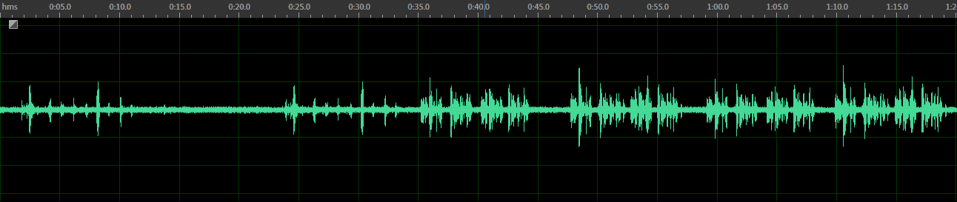
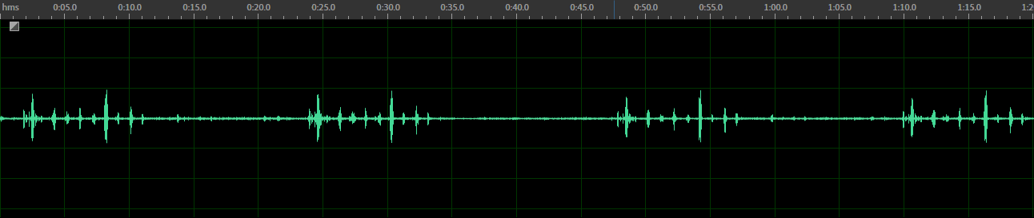

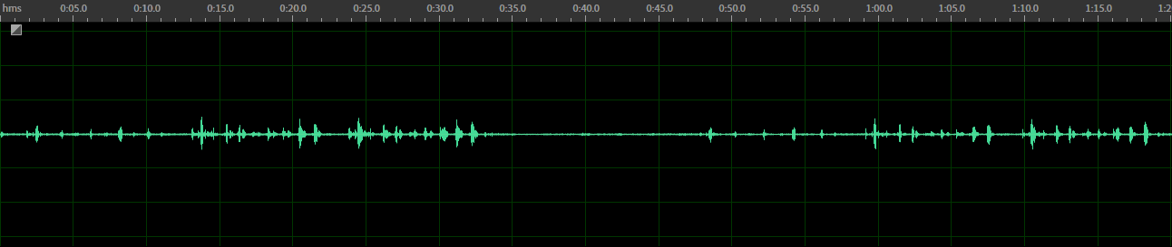
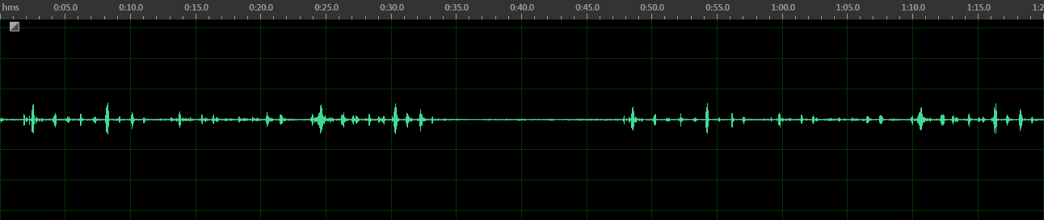
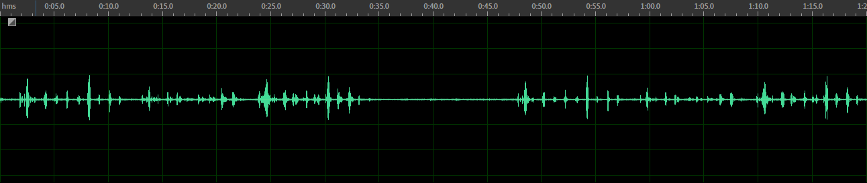
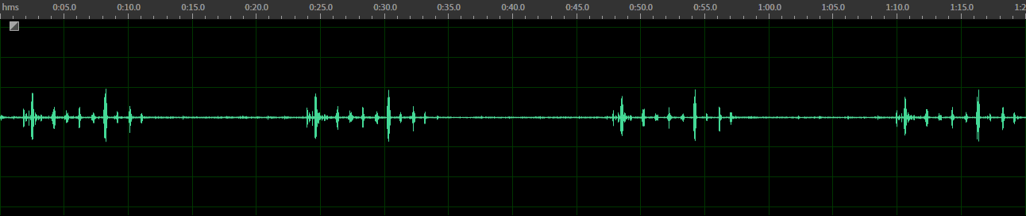
80 km/h | Mics 1-2 |  | Driver Voice | Passenger Voice | Driver + Passenger
Driver Mic Only | Mic 1 only Raw Audio
 | Mic 1 only w/ Alango EC+NR
Passenger Mic Only | Mic 2 only Raw Audio
 | Mic 2 only w/ Alango EC+NR
Dual Mic Driver + Passenger | Simple sum of post-ECNR signals (averaging) results in attenuation of both voices by -6dB (provided for comparison to Intelligent Mixer output)
 | Intelligent Mixing mode (IMT): both voices are enhanced
 | Passenger rejection mode (SST): driver’s voice is preserved

Slide 11
80 km/h | Mics 1-2 | With echo |  | Echo Only | Driver + Echo | Passenger + Echo | Driver + Passenger + Echo
Driver Mic Only | Mic 1 only Raw Audio
 | Mic 1 only w/ Alango EC+NR
Passenger Mic Only | Mic 2 only Raw Audio
 | Mic 2 only w/ Alango EC+NR
Dual Mic Driver + Passenger | Simple sum of post-ECNR signals (averaging) results in attenuation of both voices by -6dB (provided for comparison to Intelligent Mixer output)
 | Intelligent Mixing mode (IMT): both voices are enhanced
 | Passenger rejection mode (SST): driver’s voice is preserved

